Slide 1

Principles of prepregnancy care
Dr. Carmeline Motha
Consultant physician & Senior lecturer,
Department of Obstetrics & Gynaecology,
Faculty of Medicine, Ragama

Slide 2
Maternal mortality
Death of a woman while pregnant or within 42 days of termination of pregnancy,
irrespective of the duration and the site of the pregnancy,
from any cause related to or aggravated by the pregnancy or its management,
but not from accidental or incidental causes.

Slide 3
No of maternal deaths
-With kind permission of the Family Health Bureau.

Slide 4
- With kind permission of the Family Health Bureau.

Slide 5
Maternal mortality ratio 1995-2012
-With kind permission of the Family Health Bureau.

Slide 6
obstetric
Haemorrhage
Amniotic Fluid Embolism
Liver Disease
- With kind permission of the Family Health Bureau.

Slide 7

Preconception care
Provision of biomedical, behavioural and social health interventions to women and couples before conception occurs, aimed at improving their health status, and reducing behaviours and environmental factors that could contribute to poor maternal and child health outcomes.

Slide 8

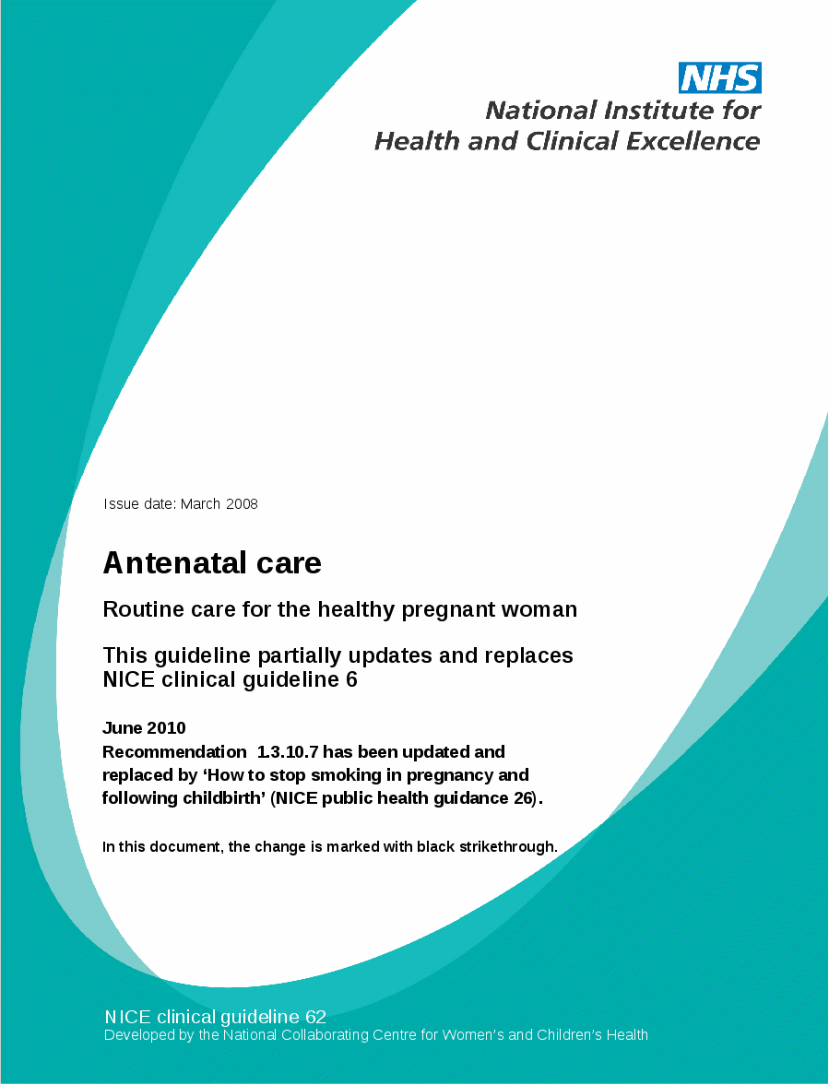
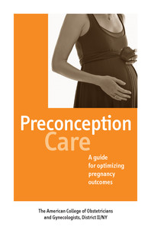

Slide 9
Benefits
Reduction in pregnancies that are too early, that are too close, unplanned pregnancies and abortions
Improved maternal morbidity & mortality
Better perinatal and neonatal health
-Reduction in stillbirths, preterm births and low birth weight babies

Slide 10
Benefits
Improved maternal nutrition
Improved fertility
Increased awareness and attention to men’s health
Opportunity to improve mental health
Economic benefits to the family and community

Slide 11
Benefits
Social benefits such as empowerment of women, better communication and more shared decision making by couples
Improved health in later life through detection and treatment of chronic conditions

Slide 12
Risks
Intruding into the privacy of women and couples
Medicalizing reproduction
Women/couples may be stigmatized and blamed for adverse reproductive outcomes
Systems may be overwhelmed

Slide 13
Preconception counselling

Slide 14

Diabetes mellitus
Attain euglycaemia
HbA1c <6.1%
Target organ screening
Retinopathy, nephropathy, cardiac assessment
Review medications
Optimise glycaemic control, change of teratogenic drugs
Preconception folic acid
5mg daily

Slide 15

Hypertension
Maintain target BP
<150/100mmHg; <140/90 mmHg if target organ damage
Target organ screening
Nephropathy, cardiac assessment
Review and modification of medications
ACEI, ARB, Diuretics- avoid
Refer for specialized care if secondary cause is present
Phaechromocytoma, cushings disease

Slide 16
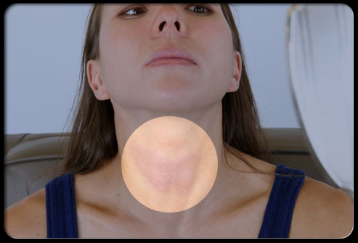
Thyroid dysfunction
Attain euthyroidism
Continue to take thyroxine
Increase the dose of thyroxine by 25% once pregnant or planning a pregnancy

Slide 17

Heart disease
Cardiology assessment on suitability for pregnancy
Suitable contraception

Slide 18

Epilepsy
Control of seizures is important
Not to stop medication when planning a pregnancy
Monotherapy with the smallest dose that control seizures
Periconceptional folic acid- 5 mg

Slide 19

Autoimmune disease
SLE, ITP, rheumatoid arthritis
6 months in remission prior to conception
Suitable and adequate contraception

Slide 20

Mental disorder
Suitability for pregnancy
Review of medications- specialist referral

Slide 21

Obesity
Associated with adverse pregnancy outcome
Congenital anomalies, preeclampsia, still birth
Ideal BMI -18.5-22.9 Kg/m2
Life style measures- dietician
Lose 10% of body weight over 6 months

Slide 22

Contraception
Essential in women not suitable for pregnancy
Temporary
Permanent

Slide 23
MEC categories for contraceptive eligibility
1 A condition for which there is no restriction for the use
of the contraceptive method
2 A condition where the advantages of using the method
generally outweigh the theoretical or proven risks
3 A condition where the theoretical or proven risks usually
outweigh the advantages of using the method
4 A condition which represents an unacceptable health
risk if the contraceptive method is used.

Slide 24

National program for preconception care

Slide 25
Action plan
Efficient preconception care at the community level
Identification of problems early
Referral to specialist care
Adequate follow up
Early booking visit once pregnant to a tertiary care hospital
Preconception clinic on Friday 8 am – room 42, OPD, NCTH, Ragama
Dietician- OPD, NCTH,Ragama
Family planning clinic- – Saturday 8 am - room 42, OPD, NCTH, Ragama

Slide 26

THANK YOU!

